Slide 1
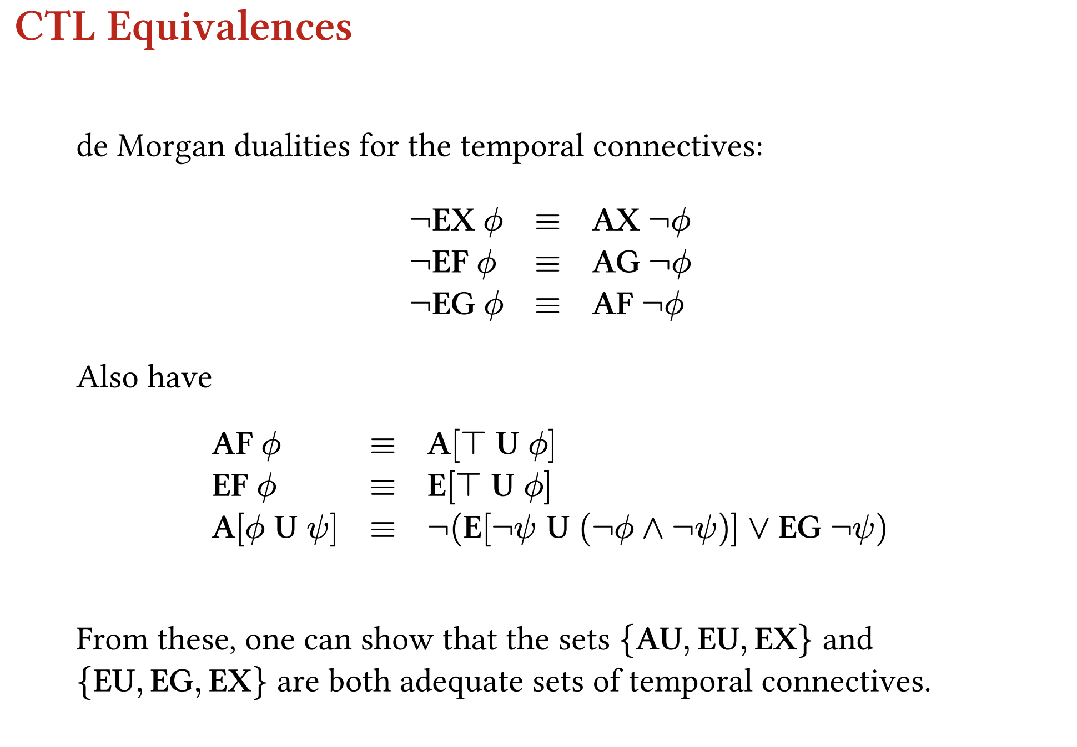
Notes:
https://www.inf.ed.ac.uk/teaching/courses/fv/slides/slides05.pdf

Slide 2
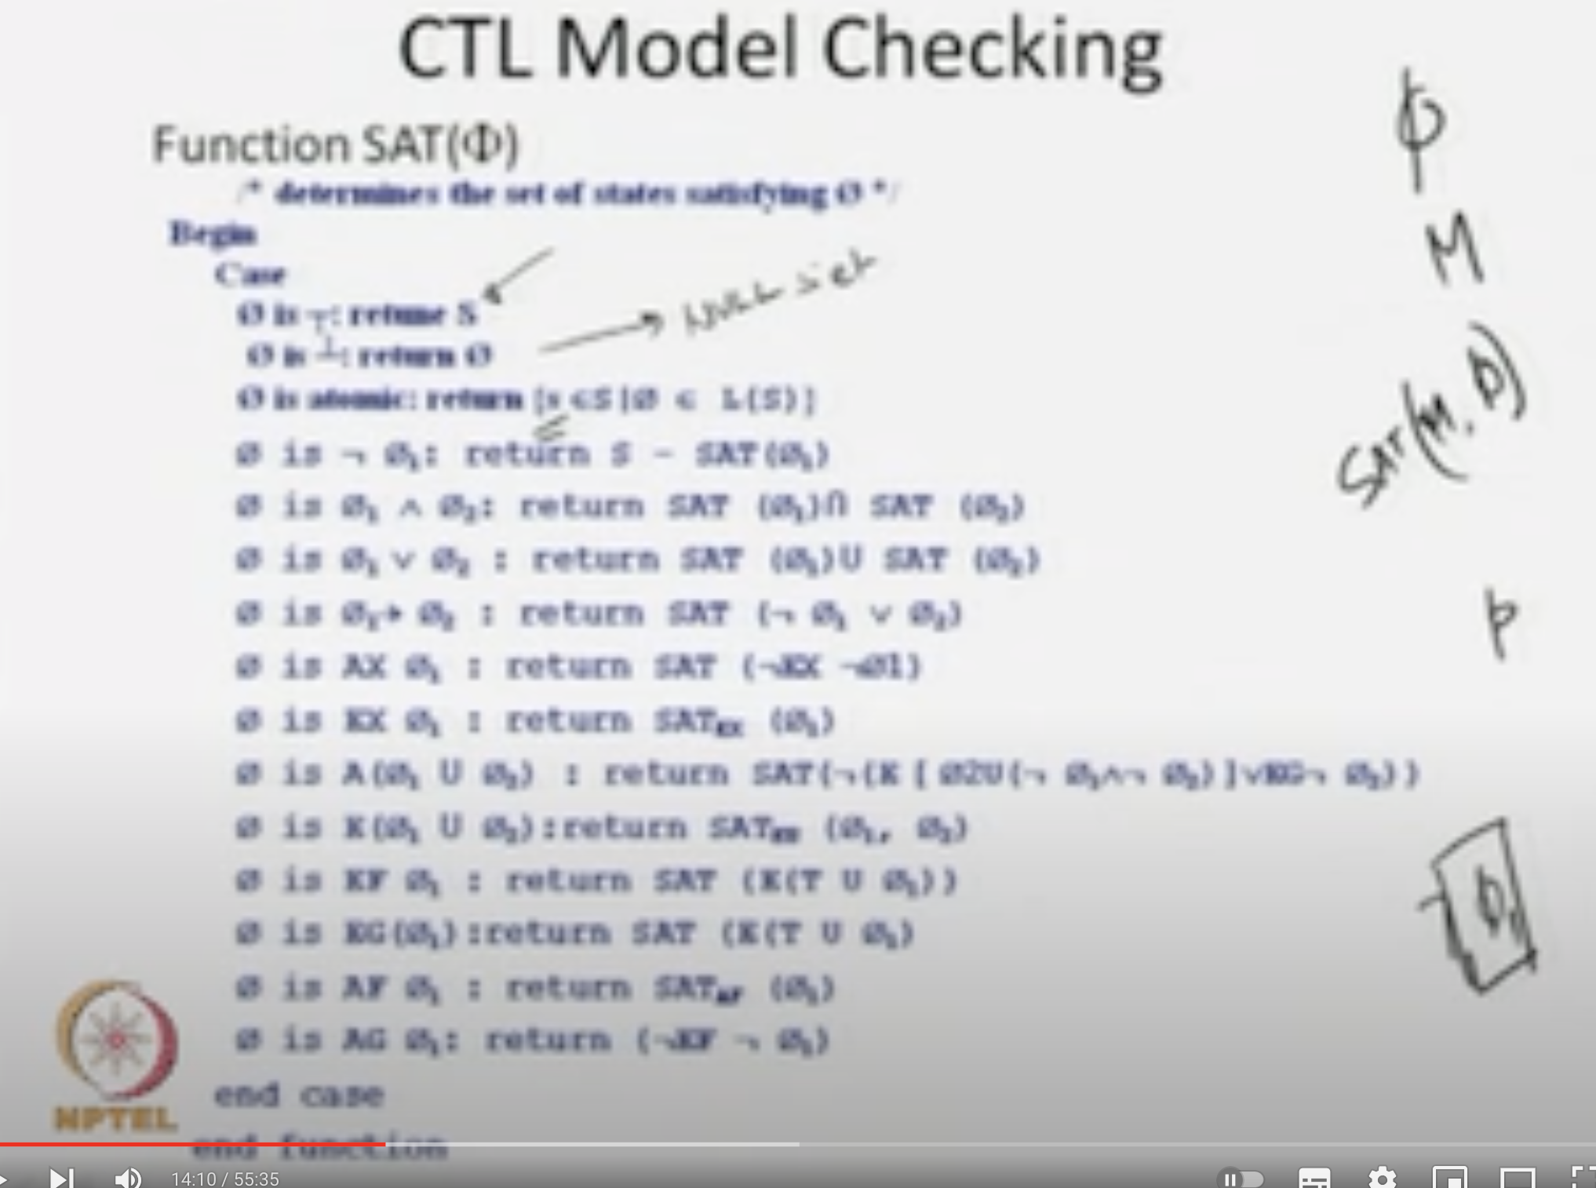
Notes:
https://www.youtube.com/watch?v=a-Xerqadt6I

Slide 3
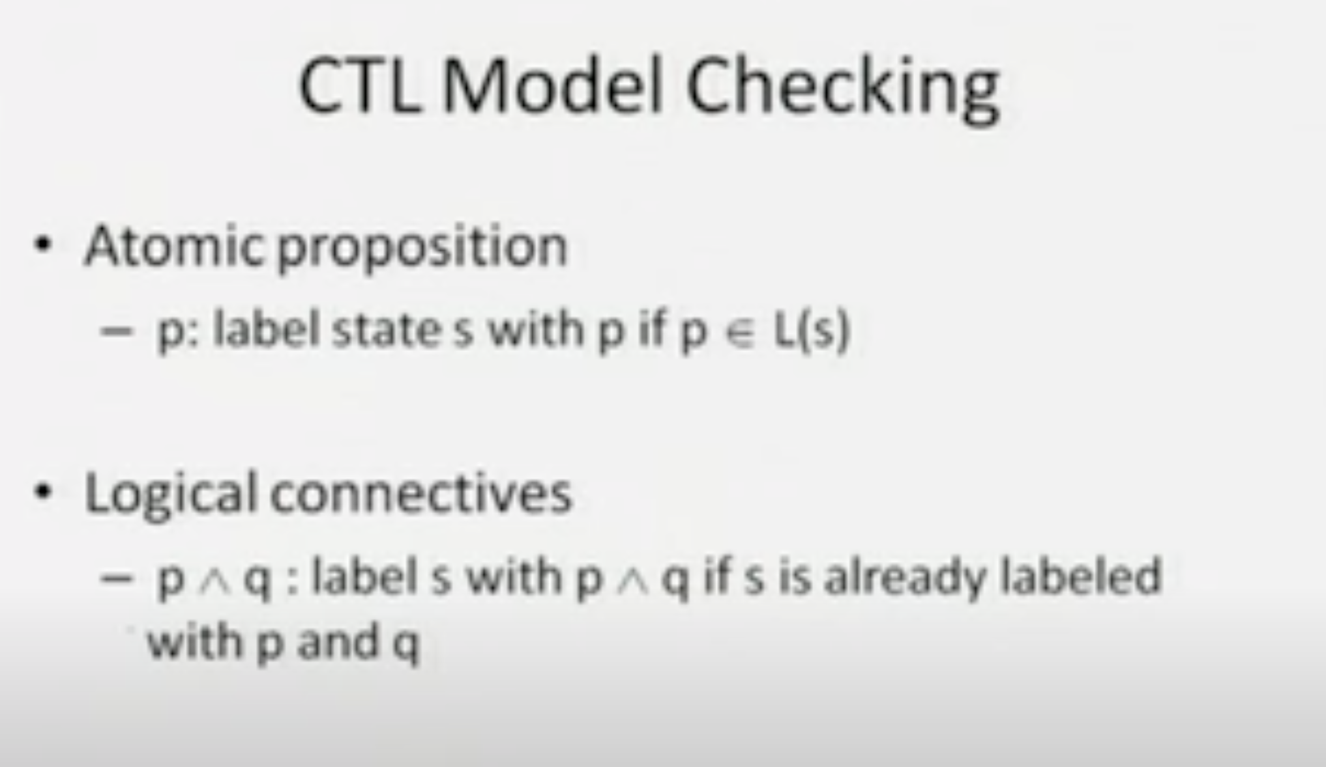
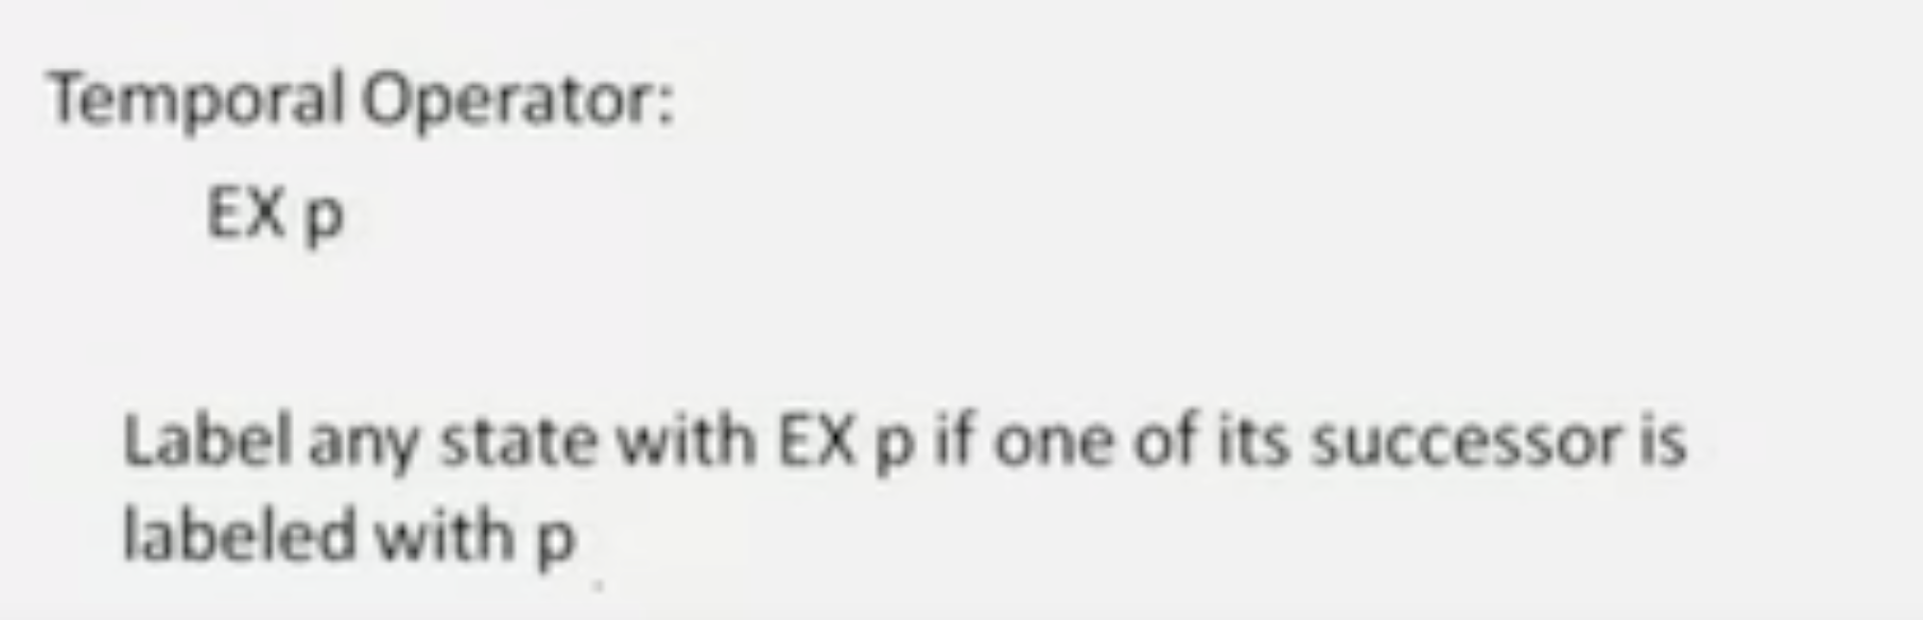

Slide 4
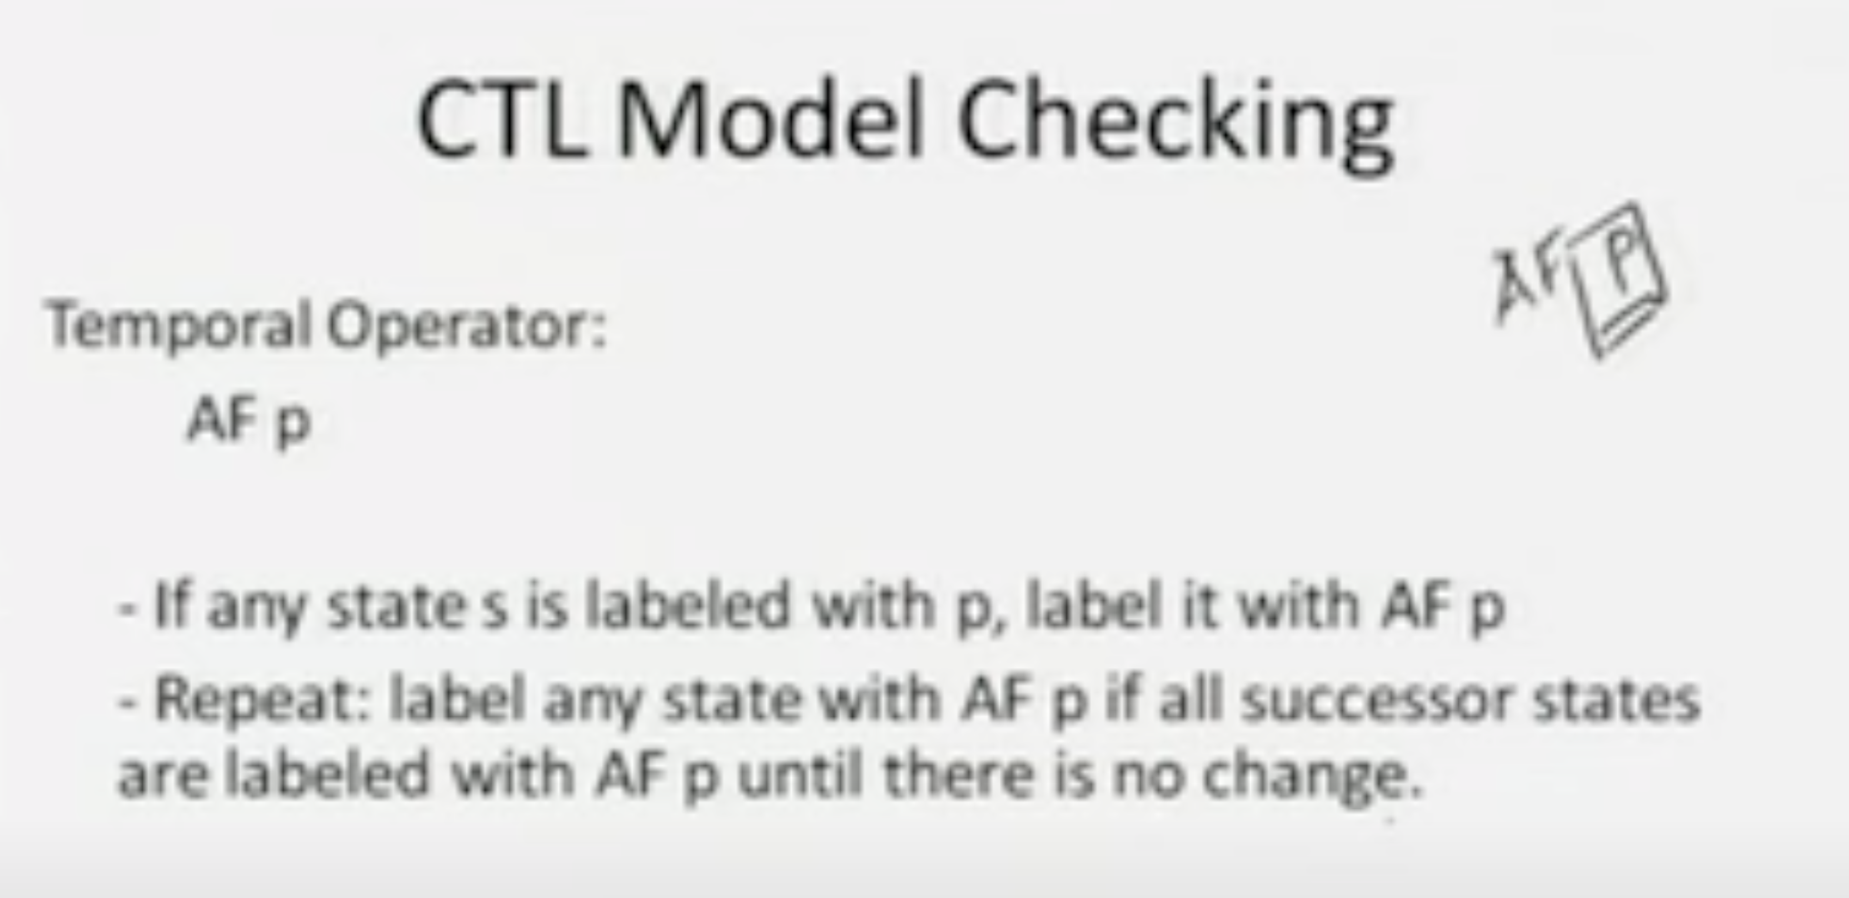
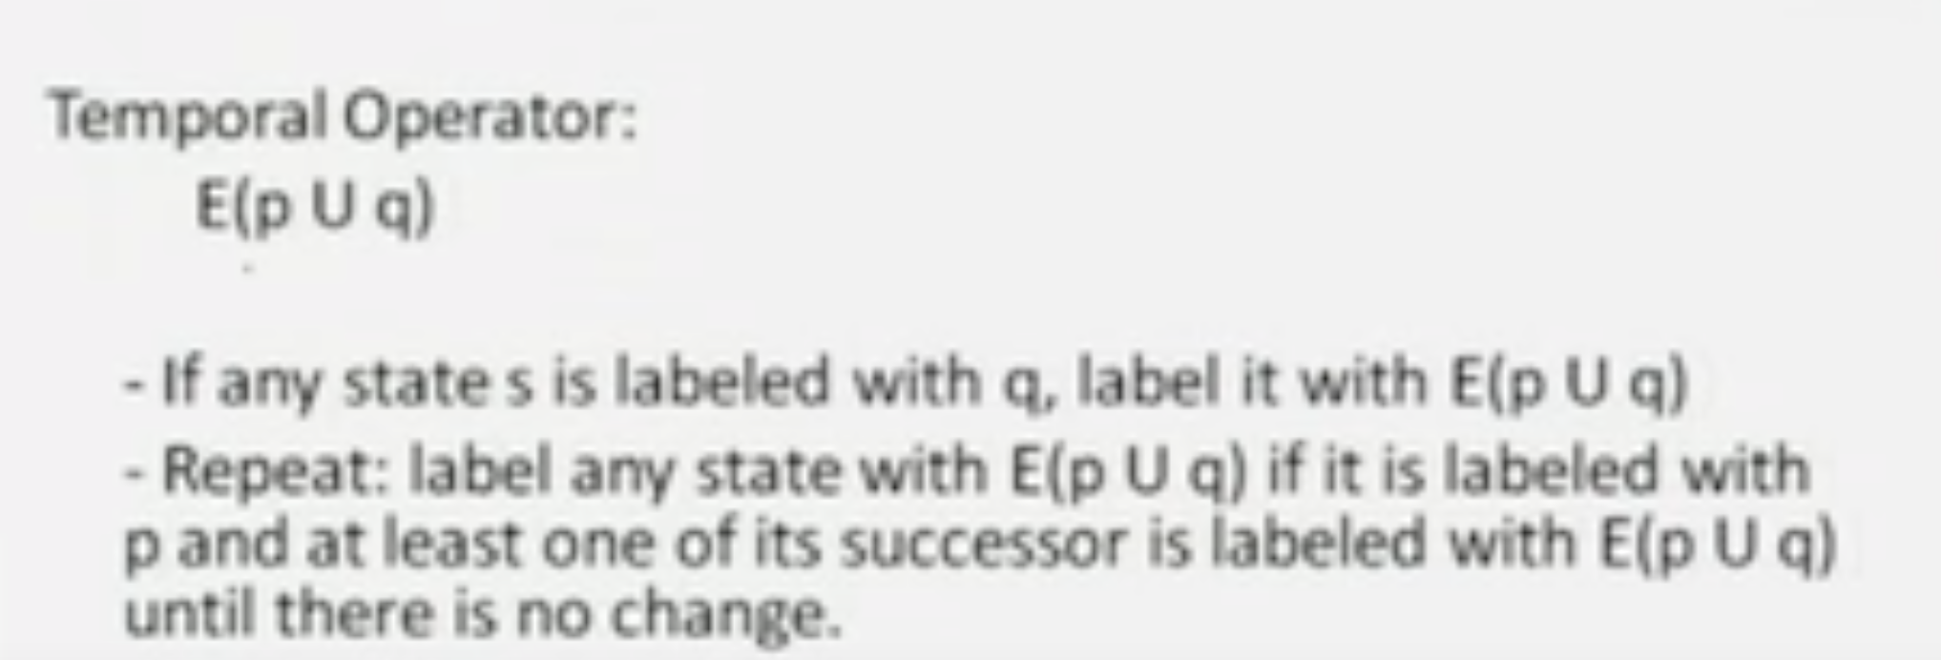
Afp = p \/ AXAFp

Slide 5
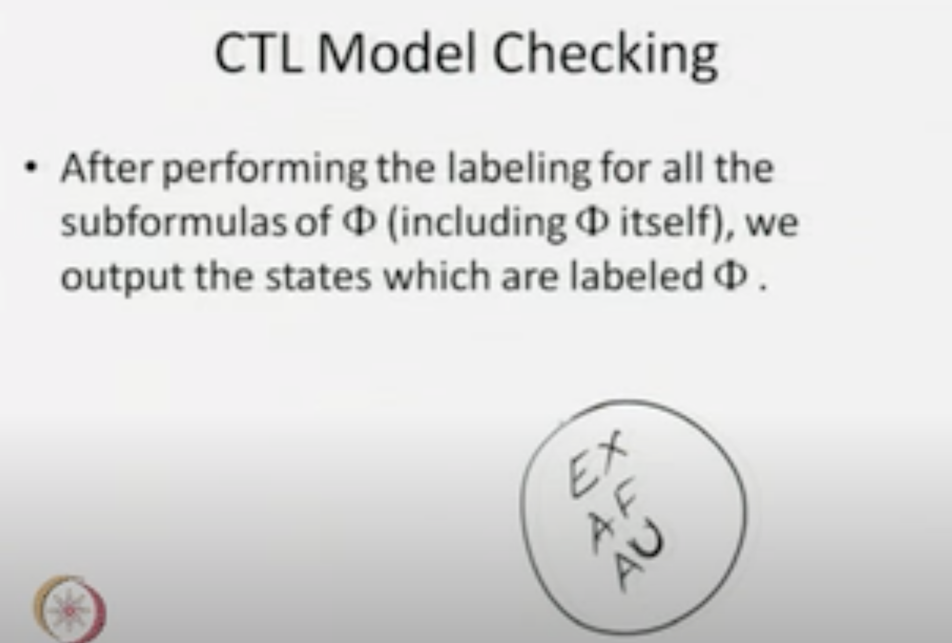

Slide 6
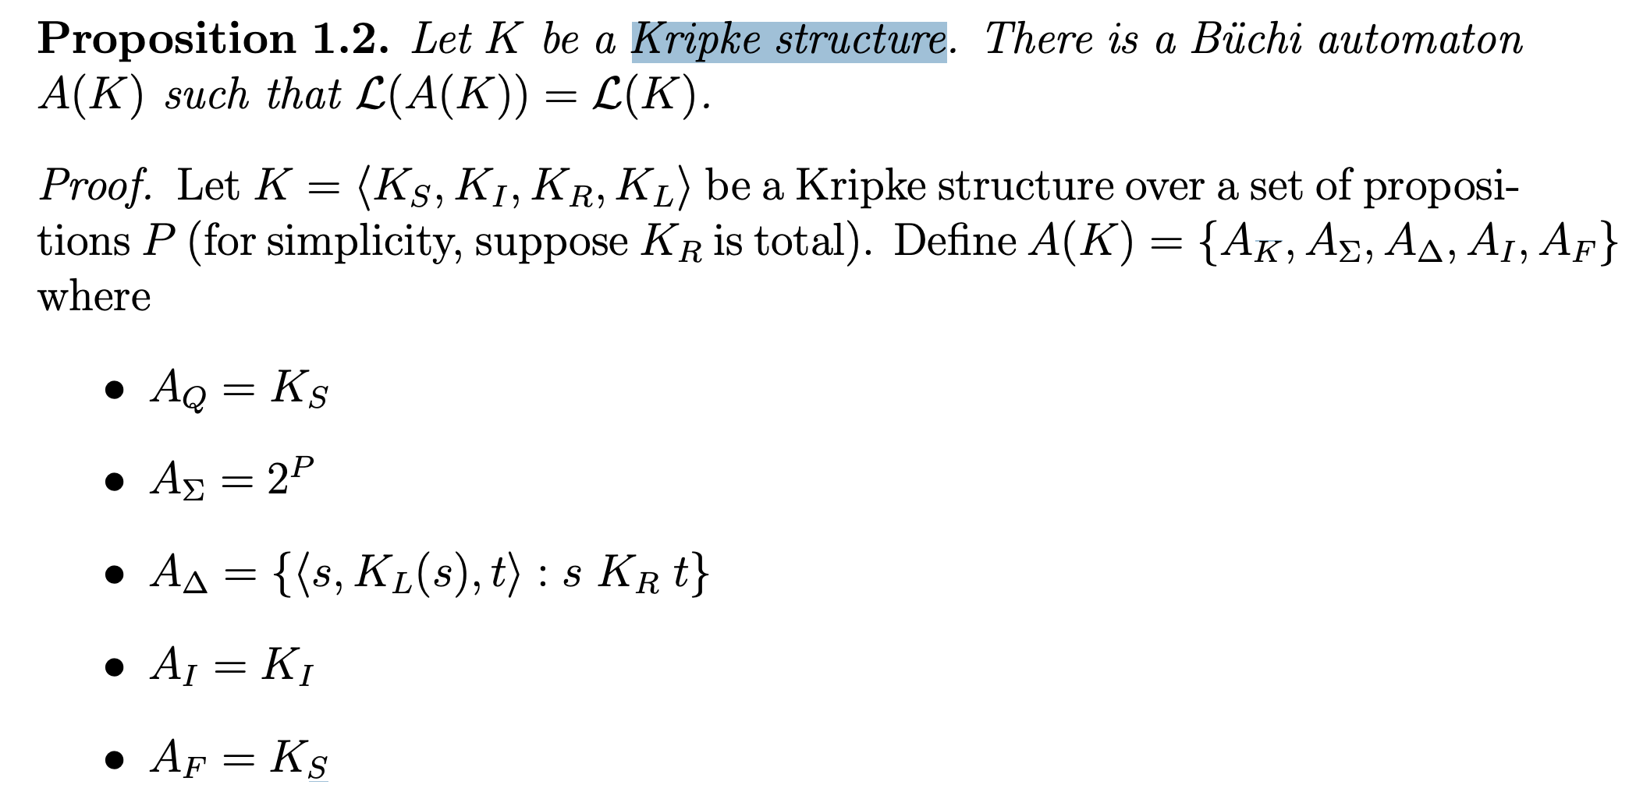
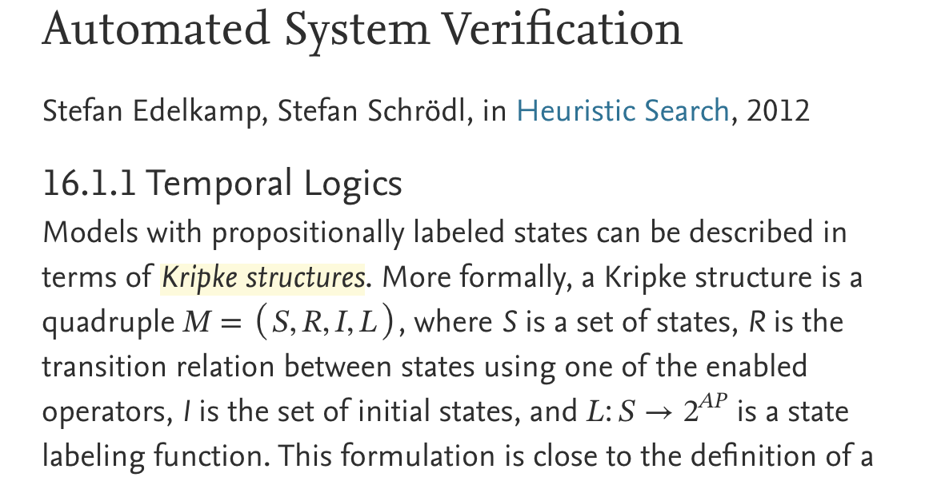
Notes:
https://www.sciencedirect.com/topics/computer-science/kripke-structure

Slide 7
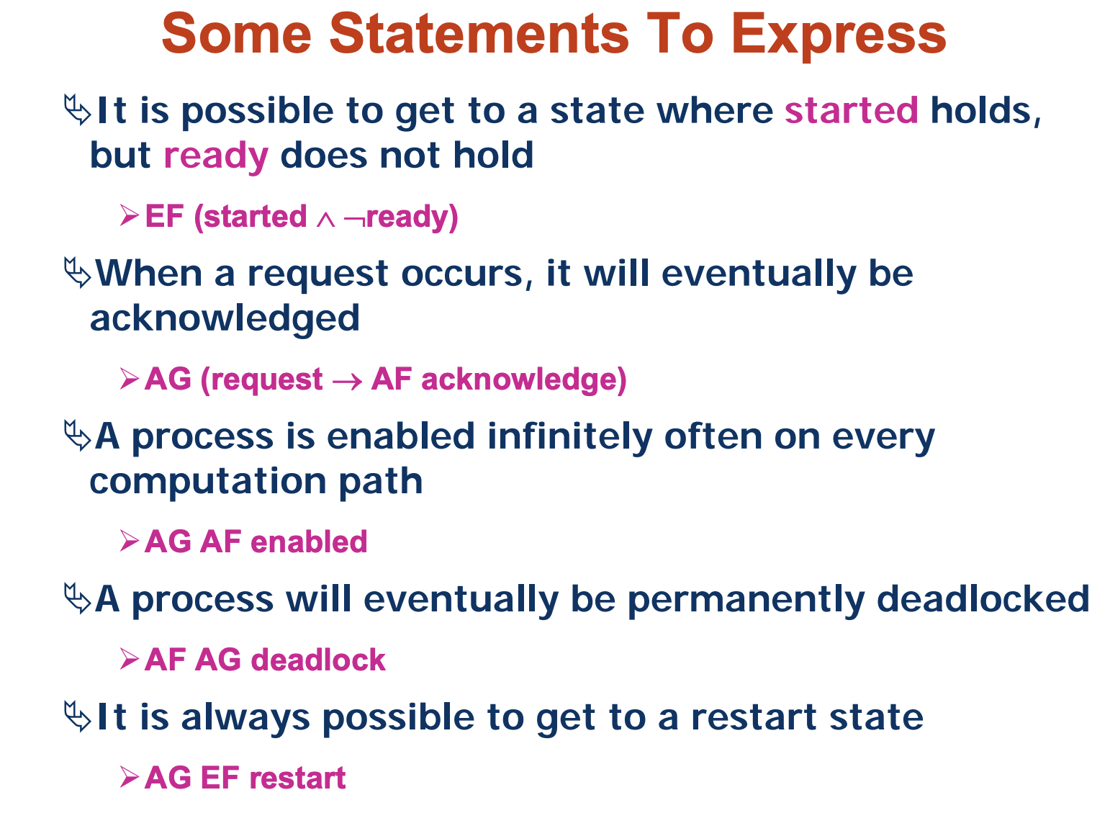

Slide 8
Datalog – CTL properties Analysis & Repair
-- A blueprint of this project
For the meeting on 14th July 2023

Slide 9
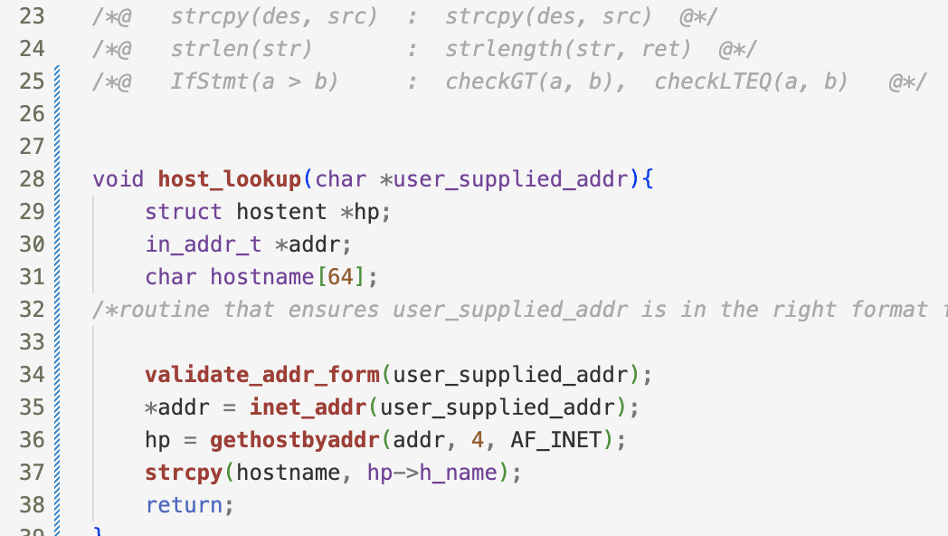
CWE-121: Stack-based Buffer Overflow
https://cwe.mitre.org/data/definitions/121.html
Facts Generation Schema
Possible Buggy Code

Slide 10
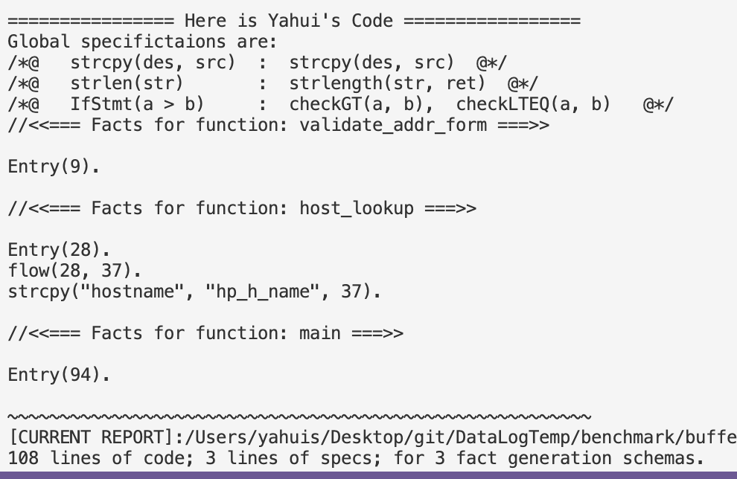

CWE-121: Stack-based Buffer Overflow
https://cwe.mitre.org/data/definitions/121.html

Slide 11
Datalog Rules for Buffer Overflow
NotBuffer_Overflow(des, src, l3) :- strcpy(des, src, l3),
transFlow(l2, l3), checkGT(a, b, l2), strlength(des, a, _),strlength(src, b, _),
transFlow(l1, l2), Entry (l1).
Buffer_Overflow (des, src, l) :- strcpy(des, src, l), ! NotBuffer_Overflow(des, src, l).
FinallyBuffer_Overflow (x) :- Buffer_Overflow (_, _, x).
FinallyBuffer_Overflow (x) :- transFlow(x, loc), Buffer_Overflow (_, _, loc).
AG_NotBuffer_Overflow(x) :- Entry(x), ! FinallyBuffer_Overflow(x).
Rules with Temporal Operators can
be generated automatically !
Query: AG(NotBuffer_Overflow)

Slide 12
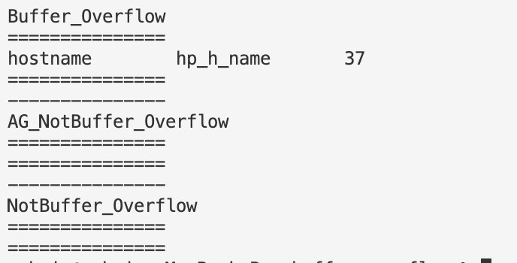
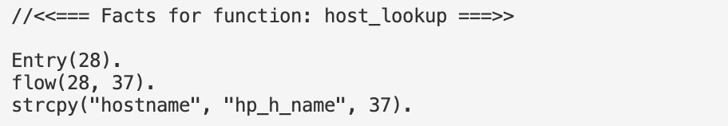
Test it out!

Slide 13
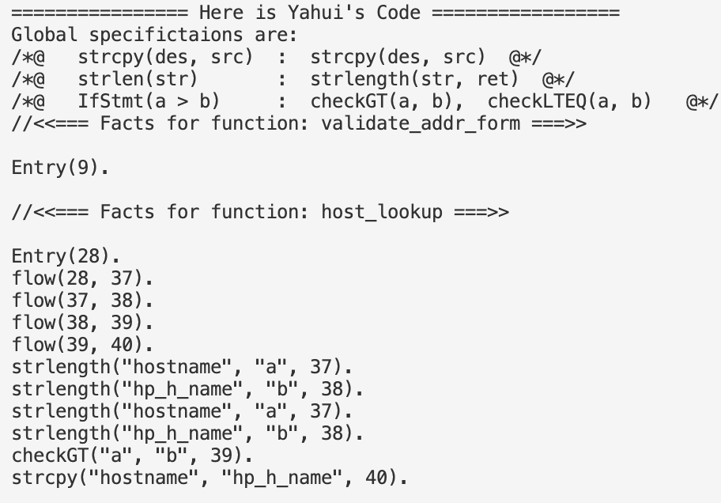
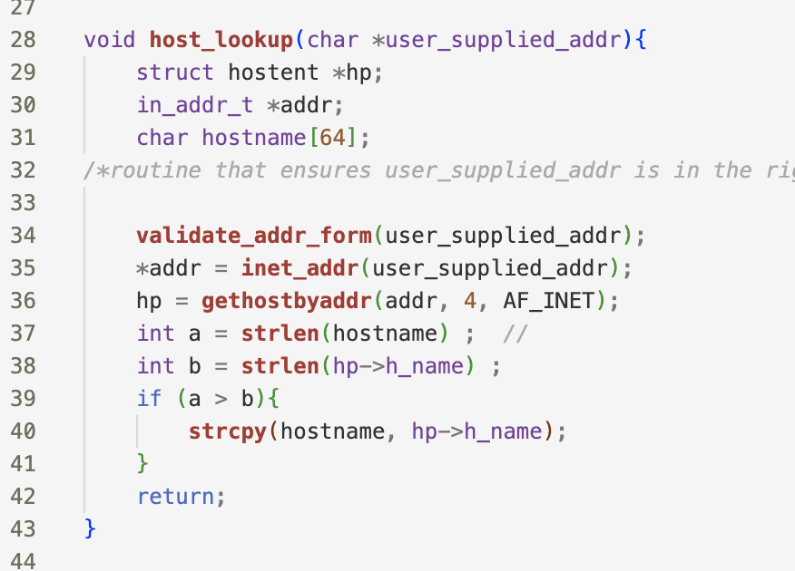
Correct Case

Slide 14
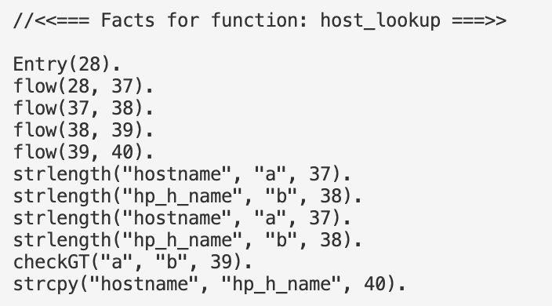
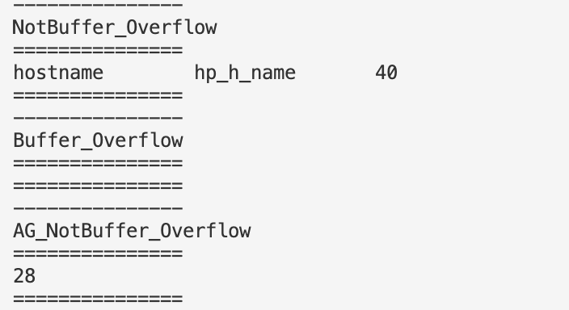
Test it out!

Slide 15
Test it out!
The repair work

Slide 16
The repair work
NotBuffer_Overflow(des, src, l3) :- strcpy(des, src, l3),
transFlow(l2, l3), checkGT(a, b, l2), strlength(des, a, _),strlength(src, b, _),
transFlow(l1, l2), Entry (l1).
Buffer_Overflow (des, src, l) :- strcpy(des, src, l), ! NotBuffer_Overflow(des, src, l).
FinallyBuffer_Overflow (x) :- Buffer_Overflow (_, _, x).
FinallyBuffer_Overflow (x) :- transFlow(x, loc), Buffer_Overflow (_, _, loc).
AG_NotBuffer_Overflow(x) :- Entry(x), ! FinallyBuffer_Overflow(x).
Target is + AG_NotBuffer_Overflow(28)
➔ - FinallyBuffer_Overflow(28)

Slide 17
The repair work
NotBuffer_Overflow(des, src, l3) :- strcpy(des, src, l3),
transFlow(l2, l3), checkGT(a, b, l2), strlength(des, a, _),strlength(src, b, _),
transFlow(l1, l2), Entry (l1).
Buffer_Overflow (des, src, l) :- strcpy(des, src, l), ! NotBuffer_Overflow(des, src, l).
FinallyBuffer_Overflow (x) :- Buffer_Overflow (_, _, x).
FinallyBuffer_Overflow (x) :- transFlow(x, loc), Buffer_Overflow (_, _, loc).
AG_NotBuffer_Overflow(x) :- Entry(x), ! FinallyBuffer_Overflow(x).
Target is + AG_NotBuffer_Overflow(28)
- FinallyBuffer_Overflow(28)
➔ - Buffer_Overflow (_, _, 37)

Slide 18
The repair work
NotBuffer_Overflow(des, src, l3) :- strcpy(des, src, l3),
transFlow(l2, l3), checkGT(a, b, l2), strlength(des, a, _),strlength(src, b, _),
transFlow(l1, l2), Entry (l1).
Buffer_Overflow (des, src, l) :- strcpy(des, src, l), ! NotBuffer_Overflow(des, src, l).
FinallyBuffer_Overflow (x) :- Buffer_Overflow (_, _, x).
FinallyBuffer_Overflow (x) :- transFlow(x, loc), Buffer_Overflow (_, _, loc).
AG_NotBuffer_Overflow(x) :- Entry(x), ! FinallyBuffer_Overflow(x).
Target is + AG_NotBuffer_Overflow(28)
- FinallyBuffer_Overflow(28)
- Buffer_Overflow (_, _, 37)
➔ + NotBuffer_Overflow(_, _, 37)

Slide 19
The repair work
Will this be able to be handled by the existing work?
NotBuffer_Overflow(des, src, l3) :- strcpy(des, src, l3),
transFlow(l2, l3), checkGT(a, b, l2), strlength(des, a, _),strlength(src, b, _),
transFlow(l1, l2), Entry (l1).
Buffer_Overflow (des, src, l) :- strcpy(des, src, l), ! NotBuffer_Overflow(des, src, l).
FinallyBuffer_Overflow (x) :- Buffer_Overflow (_, _, x).
FinallyBuffer_Overflow (x) :- transFlow(x, loc), Buffer_Overflow (_, _, loc).
AG_NotBuffer_Overflow(x) :- Entry(x), ! FinallyBuffer_Overflow(x).
Target is + AG_NotBuffer_Overflow(28)
- FinallyBuffer_Overflow(28)
- Buffer_Overflow (_, _, 37)
➔ + NotBuffer_Overflow(_, _, 37)
Notes:
AG(p => AF q)
AGEF p
afp(S):- findall(trans(S, T), Tlist), all_afp(Tlist).
not_afp(S) :- np(S), trans(S,T), not_afp(T).
# reach from a to b without p
nfp(a, a) :- not p(a)
nfp(a, b) :- not p(b), flow(a,c), nfp(a,c)
afp(a, b) :- not nfp(a, b)

Slide 20
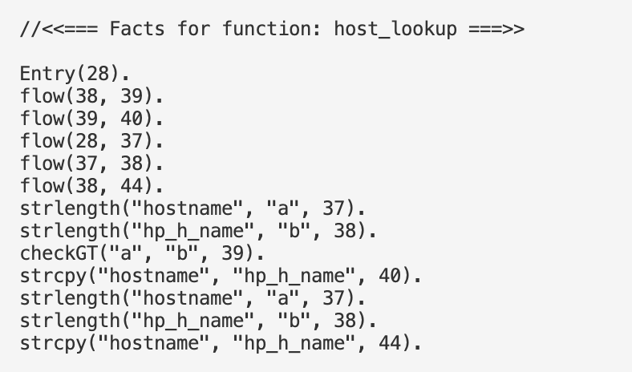
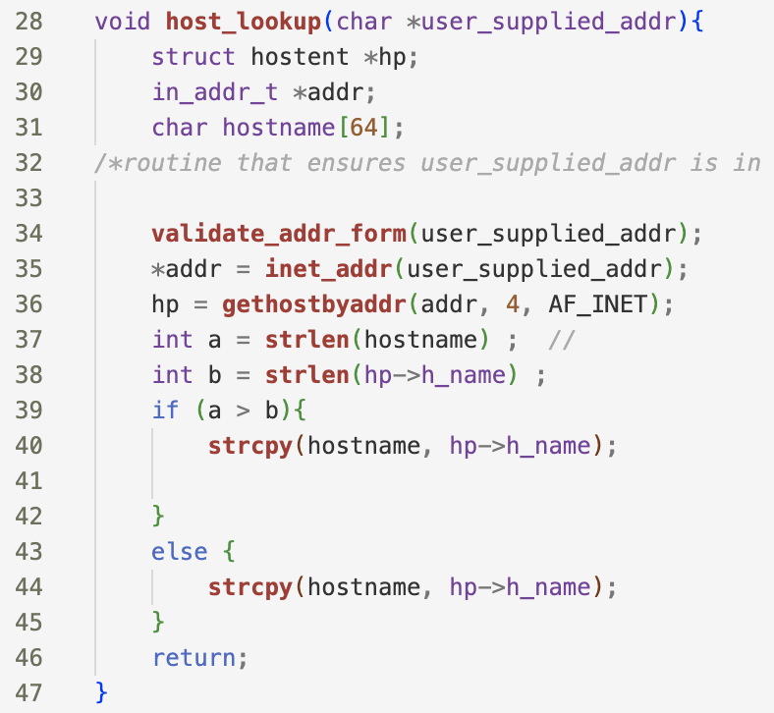
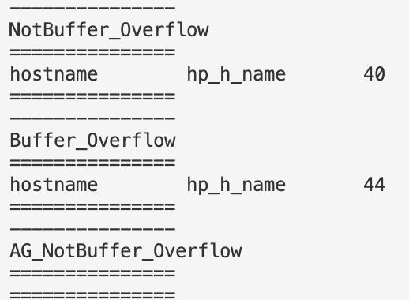
Correct
Buggy

Slide 21
Overview and Workload
User inputs:
F = Fact generation schema
R = Specific reasoning rules
T = Temporal properties queries upon R
E.g., F (R), G (R), AF (R), R1 U R2, AGEF (R) ….
If T failed to hold: Use symbolic execution for Datalog to +/- facts to make T hold.
0. IDB rules propagation to deal with the negations.
1. Translating to meta-program
2. Generate symbolic formulae
3. Constraints generation use delta-debugging
Run Souffle

Slide 22
Overview and Workload
User inputs:
F = Fact generation schema
R = Specific reasoning rules
T = Temporal properties queries upon R
E.g., F (R), G (R), AF (R), R1 U R2, AGEF (R) ….
If T failed to hold: Use symbolic execution for Datalog to +/- facts to make T hold.
0. IDB rules propagation to deal with the negations.
1. Translating to meta-program
2. Generate symbolic formulae
3. Constraints generation use delta-debugging
Run Souffle
Questions:
Related work: Doop, Datalog-based analysis (?), model checking …
Why is that so important to generate facts by ourselves? Less hard-coded complication and more efficient.
<< The last slide >>

Slide 24
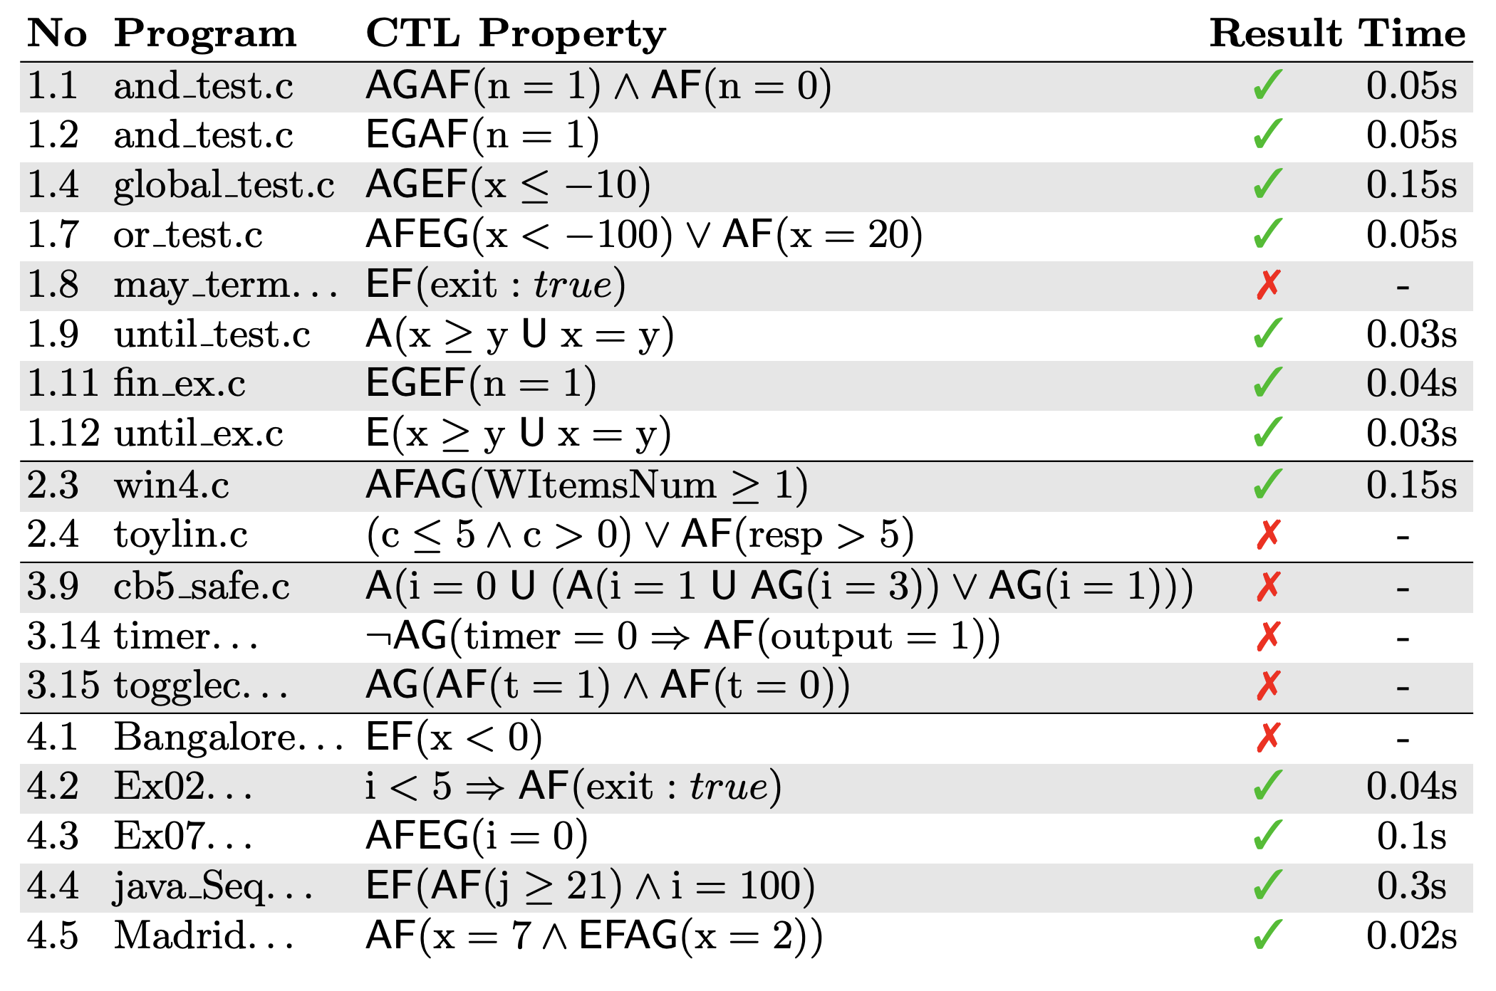
Notes:
https://caterinaurban.github.io/pdf/sas2018.pdf

Slide 25
<<18th July 2023>> Over-approximated Analyses.
Facts
a(1, 2)
c(3)
b(1, 2)
b(2, 3)
b(3, 1)
Z(x) :- a (x, y), ! b(y, z), c(z).
Z’(x) :- a (z, y), neg_b(y, z), c(z).
neg_b(a, y) :- a(x, y), c(z).
domain_x = {1}
domain_y = {2}
domain_z = {3}
#neg_b(y, z) >= # !b (y, z)
#(Z’) >= # (Z)
Notes:
Eliminate all negative atoms from the Datalog programs, then calculate the domains of symbolic constants as usual.

Slide 26
The original workflow
1. Inject symbolic values: constants, signs.
2. Convert to meta programs & compute the symbolic domain
flow (𝐶1 , 2, 𝐶1 , ... , 𝐶𝑛 ) :- domain_alpha_1 (𝐶1), ... , domain_alpha_n (𝐶𝑛 ).
3. Compute the constraints for symbolic signs…delta-debugging

Slide 27
AGEFp
efp(S) :- p(S).
efp(S) :- transition(S, T), efp(T).
n_gefp(S) :- ! efp(S).
n_gefp(S) :- transition(S, T), n_gefp(T).
agefp(S) :- ! n_gefp(S).

Slide 28
AG(p => AF q)
n_fq(S) :- ! q(S).
n_fq(S) :- transition(S, T), n_fq(T).
afq(S) :- ! n_fq(S).
p2afq(S) :- ! p(S).
p2afq(S) :- afq(S). // a => b = (!a \/ b)
n_gp2afq(S) :- ! p2afq(S).
n_gp2afq(S) :- transition(S, T), n_gp2afq(T).
a_gp2afq(S) :- ! n_gp2afq(S).

Slide 29
AG(p => AF q) Souffle accepted code
n_fq(S) :- Entry(S), ! q(S).
n_fq(S) :- transition(S, T), n_fq(T).
afq(S) :- Entry(S), ! n_fq(S).
p2afq(S) :- Entry(S), ! p(S).
p2afq(S) :- afq(S). // a => b = (!a \/ b)
n_gp2afq(S) :- Entry(S), ! p2afq(S).
n_gp2afq(S) :- transition(S, T), n_gp2afq(T).
a_gp2afq(S) :- Entry(S), ! n_gp2afq(S).

Slide 30
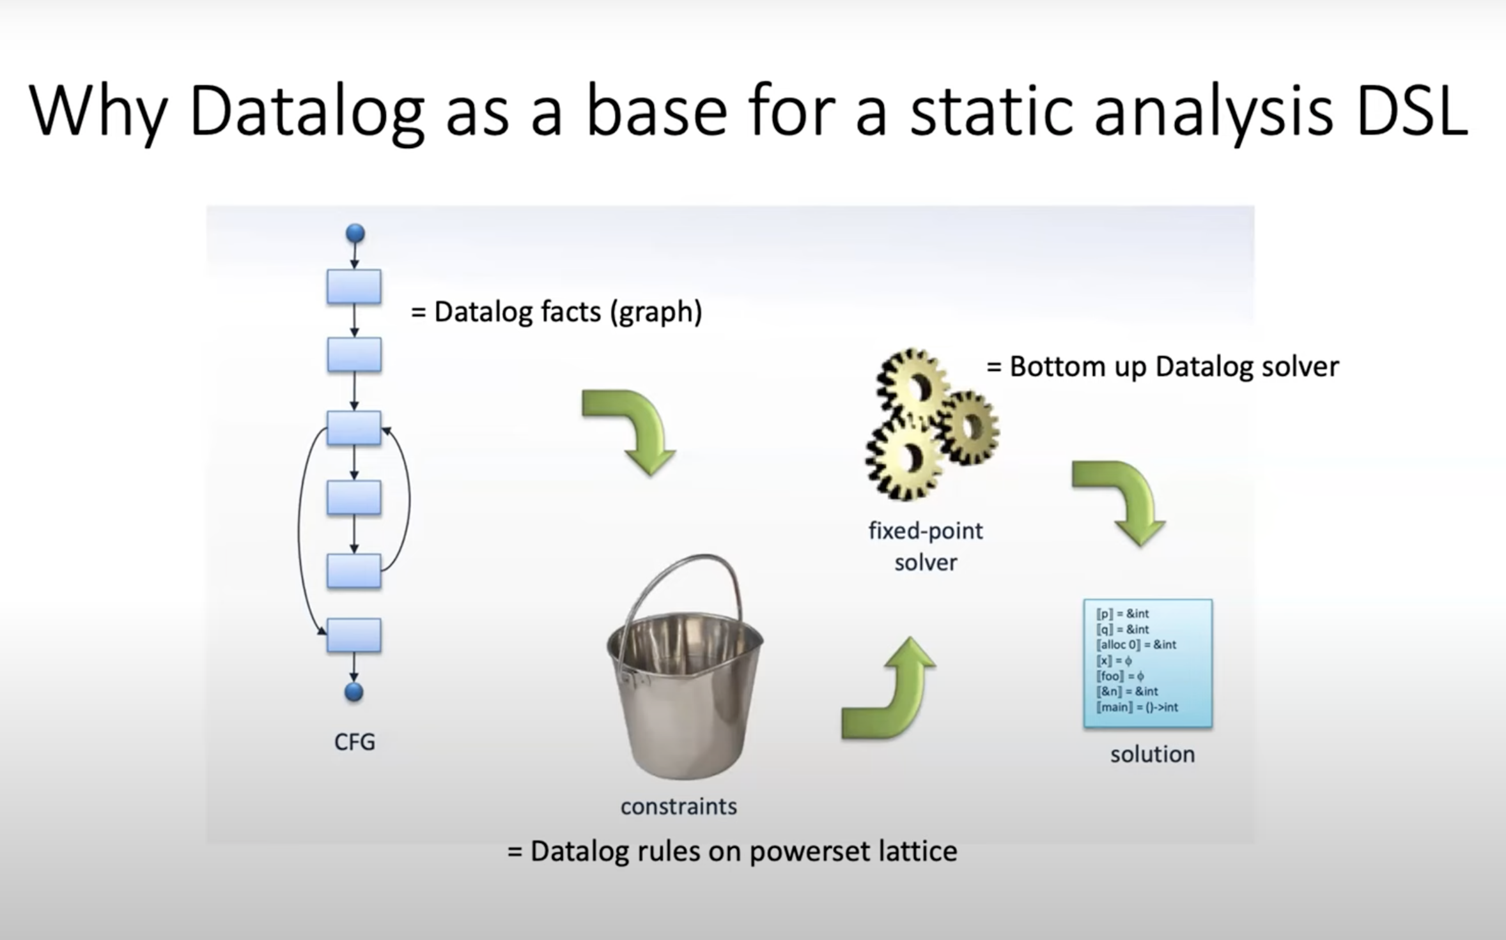
Notes:
https://www.youtube.com/watch?v=mHVIdHLp9ZQ

Slide 31
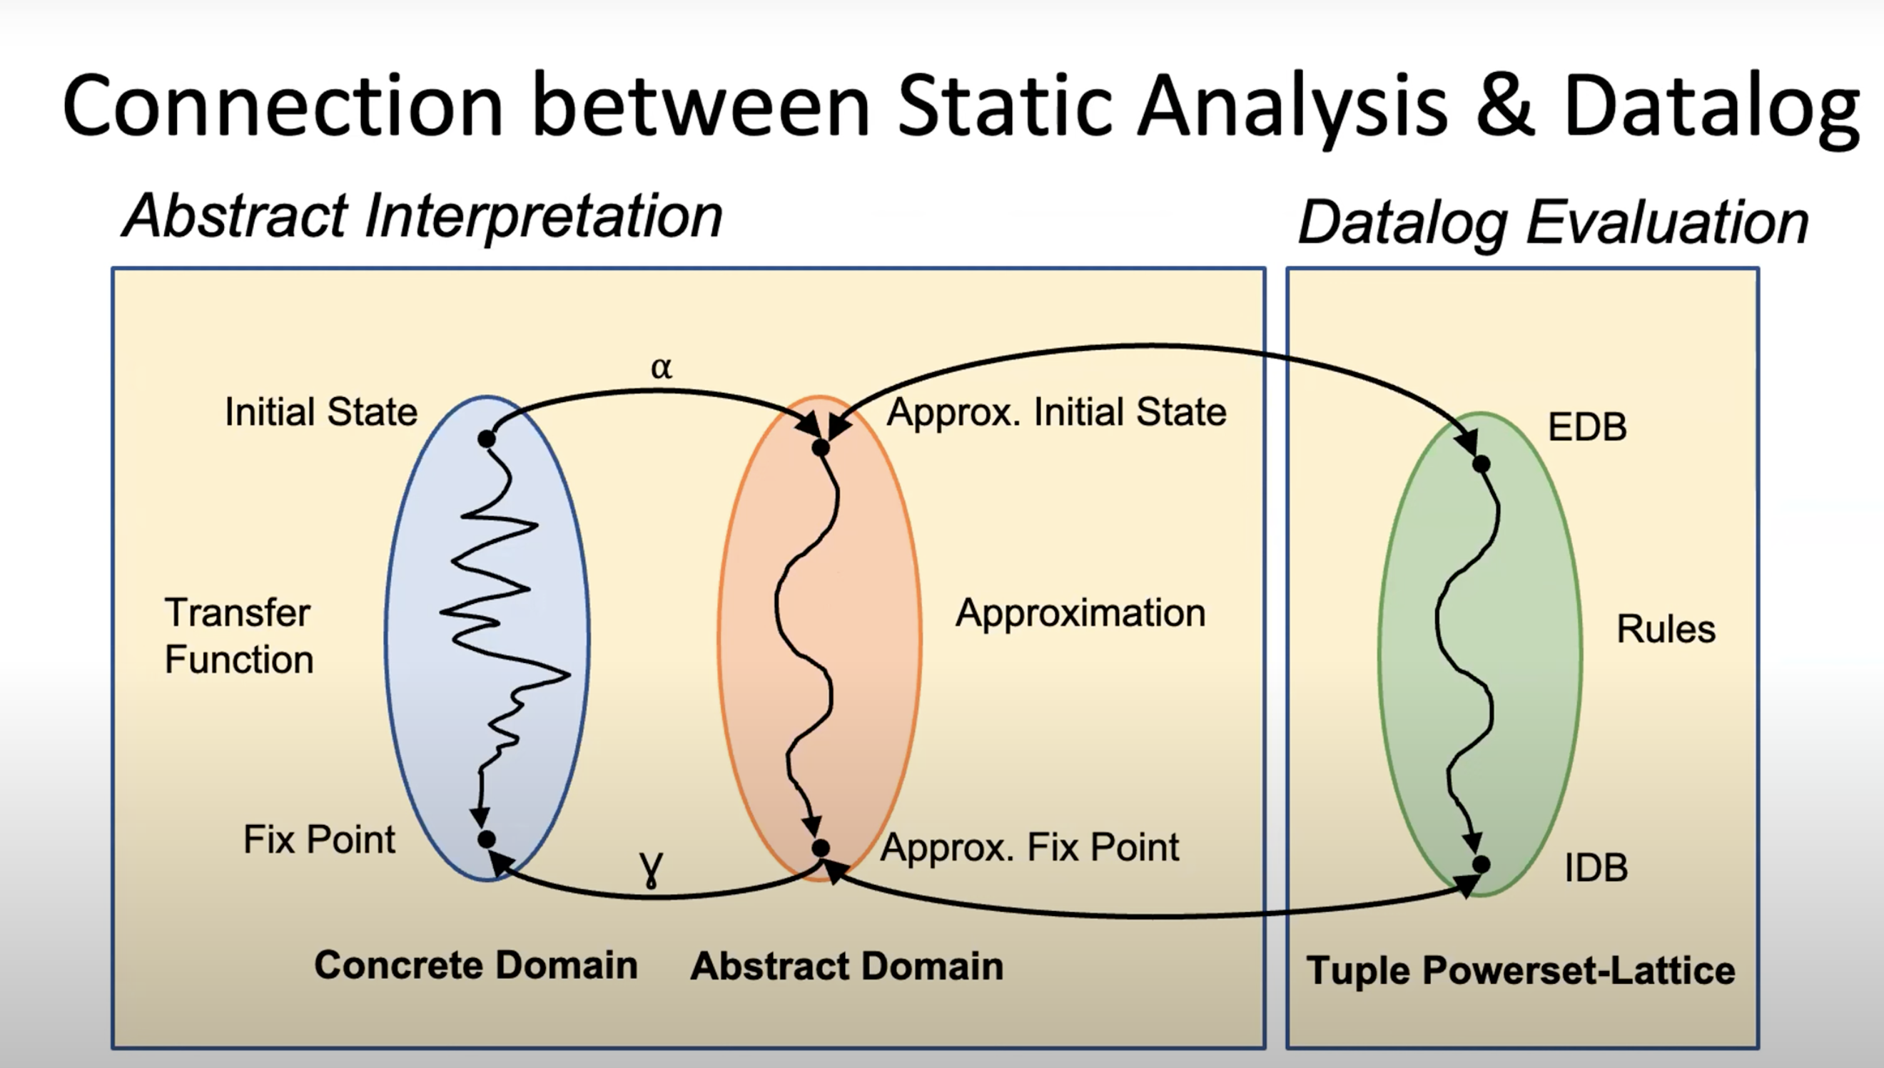

Slide 32
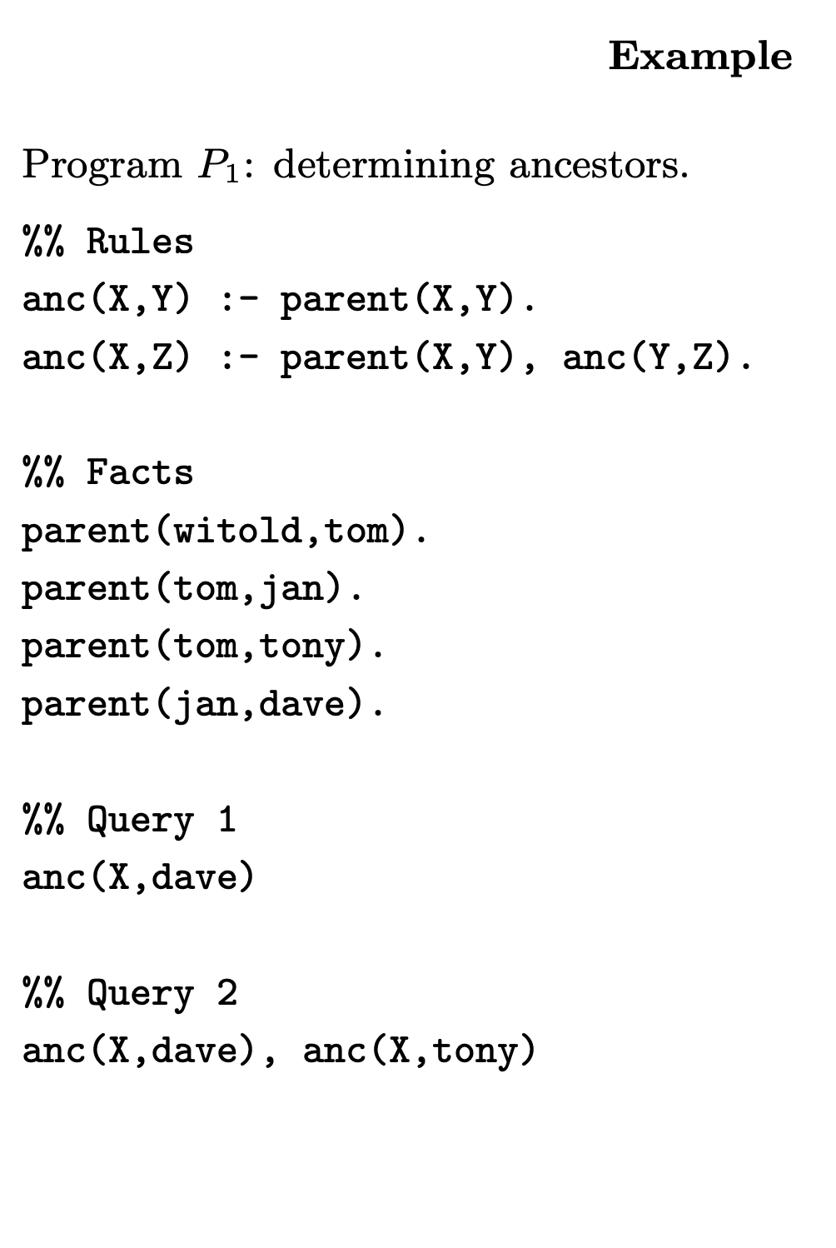
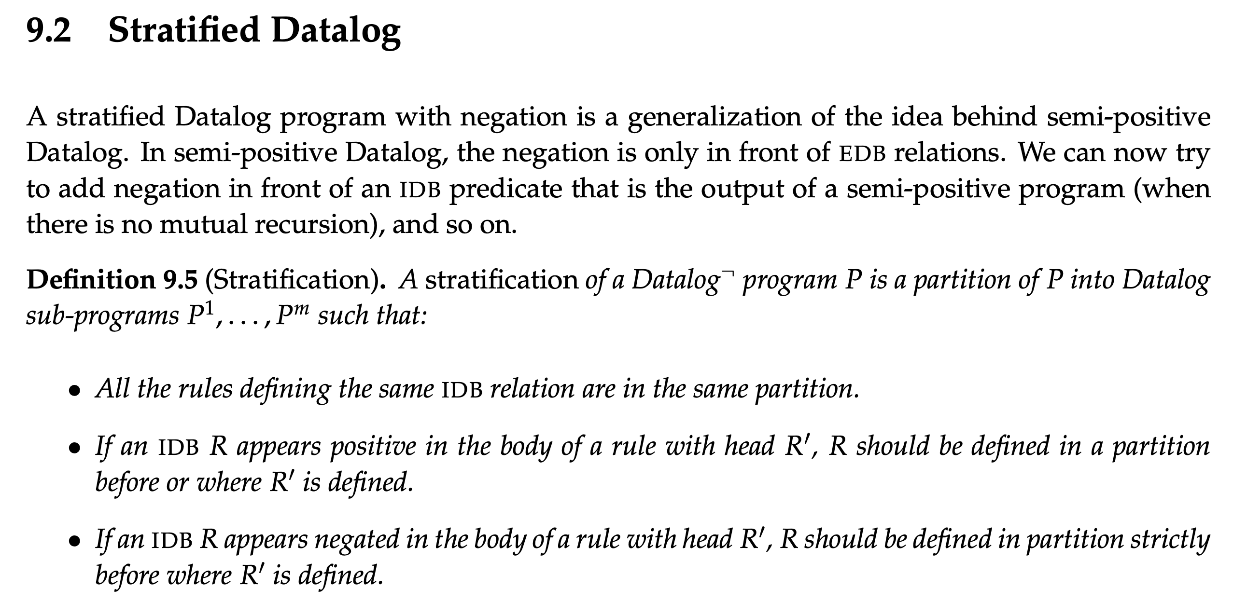
Notes:
https://cse.buffalo.edu/~chomicki/636/datalog-h.pdf
https://pages.cs.wisc.edu/~paris/cs784-s17/lectures/lecture9.pdf

Slide 33
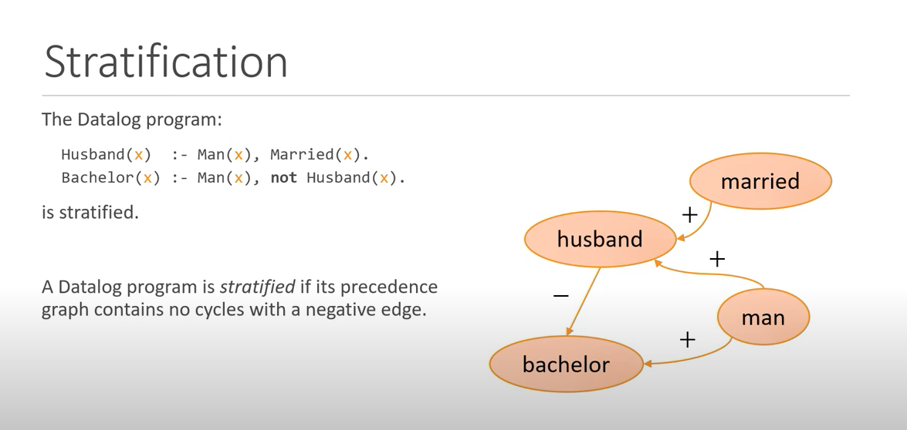
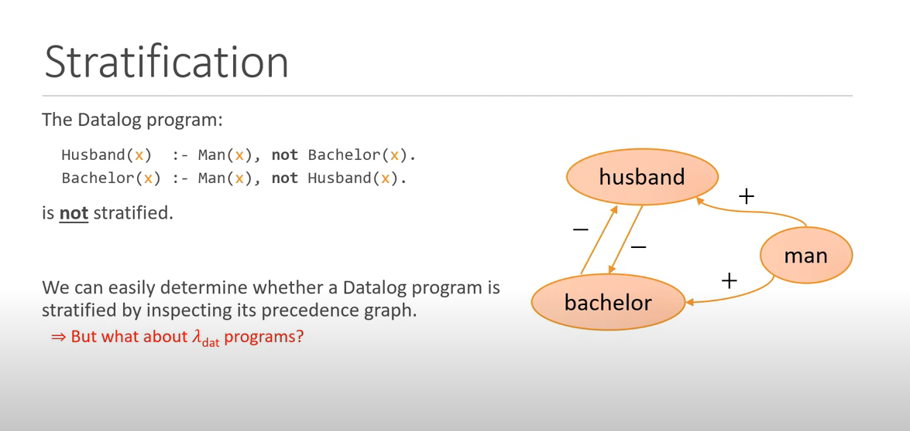
Notes:
Fixpoints for the Masses: Programming with First-Class Datalog Constraints
https://www.youtube.com/watch?v=ikVZrivln8c

Slide 34
branching time temporal logic property AGEFp
The fixed-point semantics of this property will be: gfp X. ( lfp Y.( p OR <-> Y) AND [-] X) agefp(S) :- not n_agefp(S). n_agefp(S) :- not efp(S). n_agefp(S) :- transition(S, T), n_agefp(T). efp(S) :- p(S). efp(S) :- transition(S, T), efp(T).
Forall p = not exist (not p)
agefp(S) :- not n_gefp(S). n_gefp(S) :- n_fp(S). efp(S) :- p(S). efp(S) :- transition(S, T), efp(T).
Notes:
where <-> means there exists an action and [-] means for all actions. In Datalog stratified, you can encode via predicates like
// for all path globally Efp
// exists a path which NOT globally Efp
AGEF -> Recovery problem.
Non starvation

Slide 35
Possible framework
Have user-defined rules for generating propositions as facts
we define a set of rules, as a Datalog library.
Different queries have different repair strategy:
EF(p_bad): to fix till it does not return and results.
What is the difficulty to deal with the stratified negation?

Slide 36
char* strcpy(char* destination, const char* source);
Note: When you use strcpy(), the size of the destination string should be large enough to store the copied string. Otherwise, it may result in undefined behavior.

Slide 37
User inputs:
F = Fact generation schema
R = Specific reasoning rules
T = Temporal properties Queries upon R
E.g., F (R), G (R), AF (R), R1 U R2, AGEF (R) ….
Yahui
If T failed to hold:
Use symbolic execution for Datalog to insert/delete facts to make T hold.
1. Translating to meta-program
2. Generate symbolic formulae
3. Constraints generation use delta-debugging
Liu Yu
Current TODO:
Find bug types (also benchmark) which can be encoded as R and T.
Fixe the current constraint generation process to support negations. (delta-debugging?)
Engineer: generate runnable .dl files from the user input
Supporting difference statement patterns, type check, libraries, etc.

Slide 38
Summary
Follow up work for the Datalog-based repair, Liu Yu, Sergey.
Currently: for NPE (in Java) and data leak (In python), the rules are negation free.
Final Goal: targeting on CTL bugs, which can be described using stratified negation, targeting temporal bugs or bugs which can be described using temporal properties.
Difficulties/novelty: constraint generating with rules using negation, and the facts generation for precise and lightweight temporal analysis.
Possible App: user-after-free, memory leak, buffer overflow, data race, protocol propositions.
Next step: user-defined fact generation schema, and the rules for detecting bugs.

